Slide 1
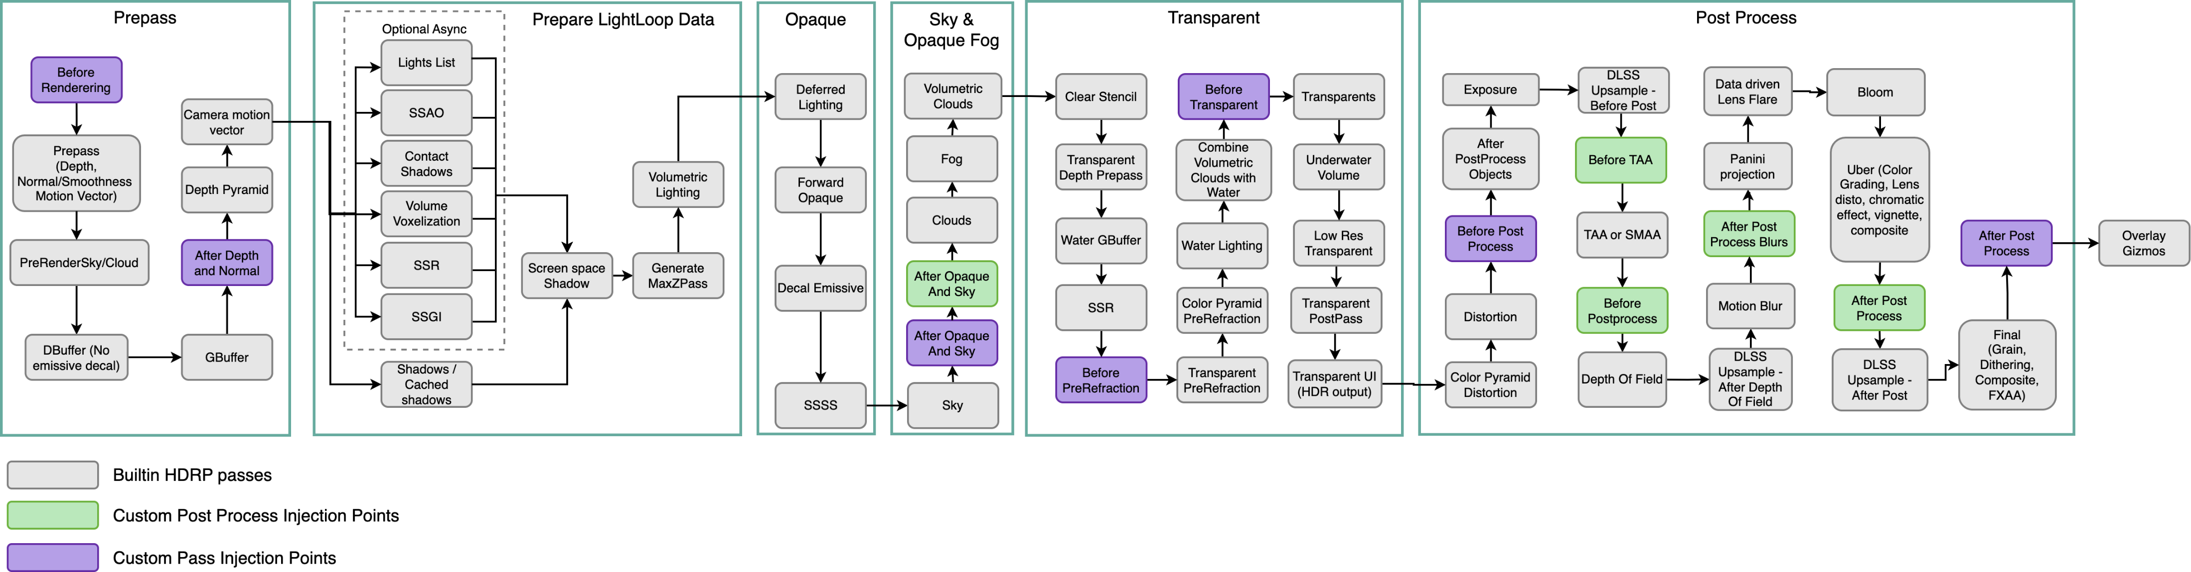

Slide 2
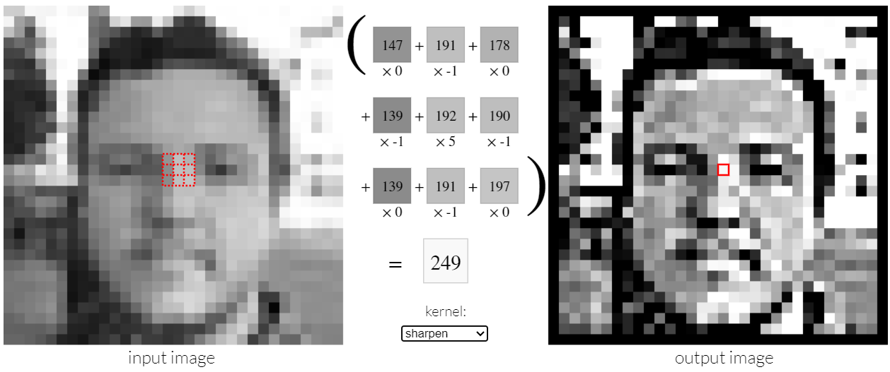

Slide 3
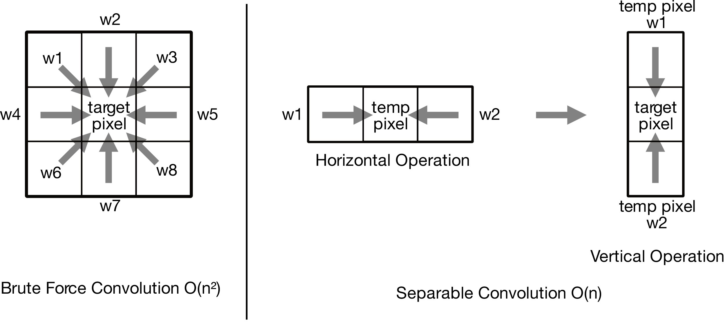

Slide 4
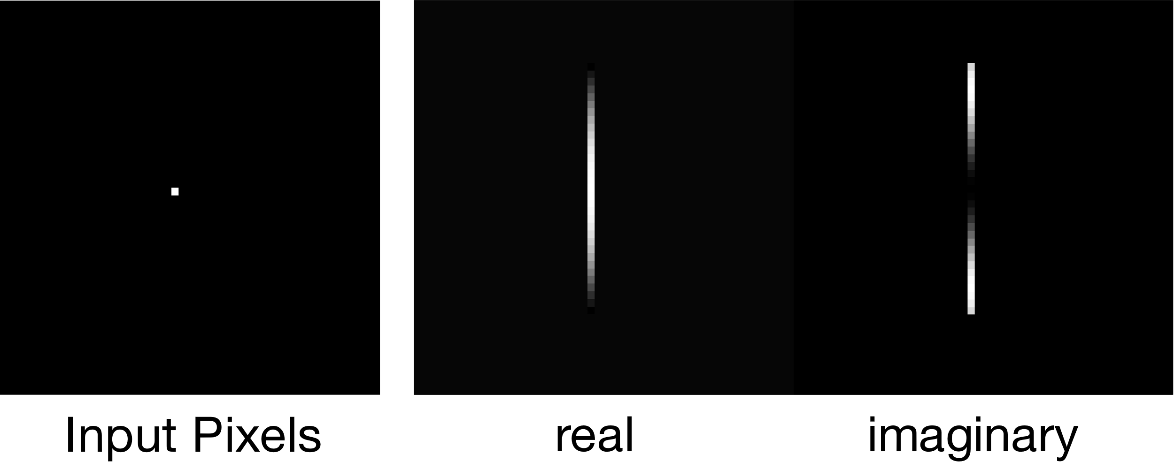
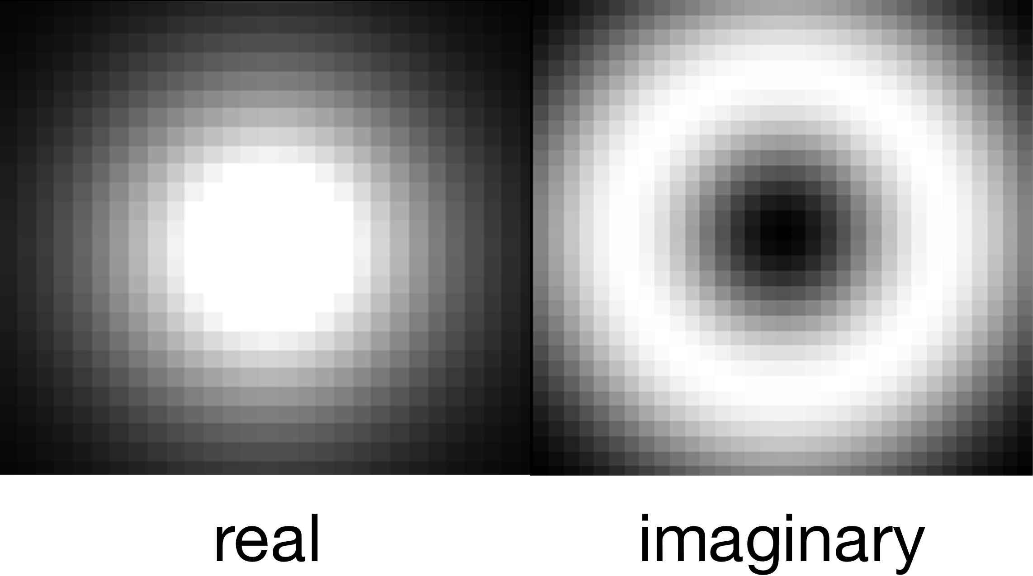

$$F\left(x\right)=e^{−ax^{2}}\left(\cos\left(bx^{2}\right)+i\sin\left(bx^{2}\right)\right)$$
$$Color\left(x\right)=A{∗F}_{real}\left(x\right)+B{∗F}_{imaginary}\left(x\right)$$

Slide 5
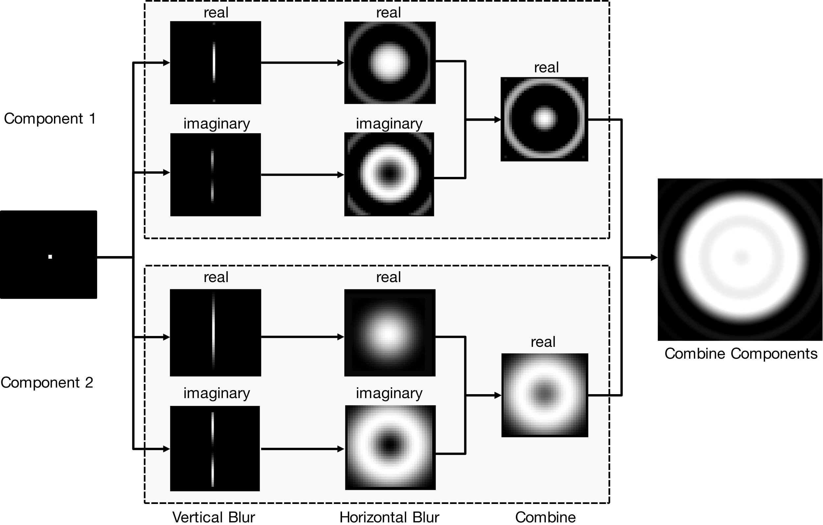

Slide 6
